Slide 1
Optimizing Supply Chain E ciency: A Case Study of Flipkart's Strategic Management Practices

Slide 2
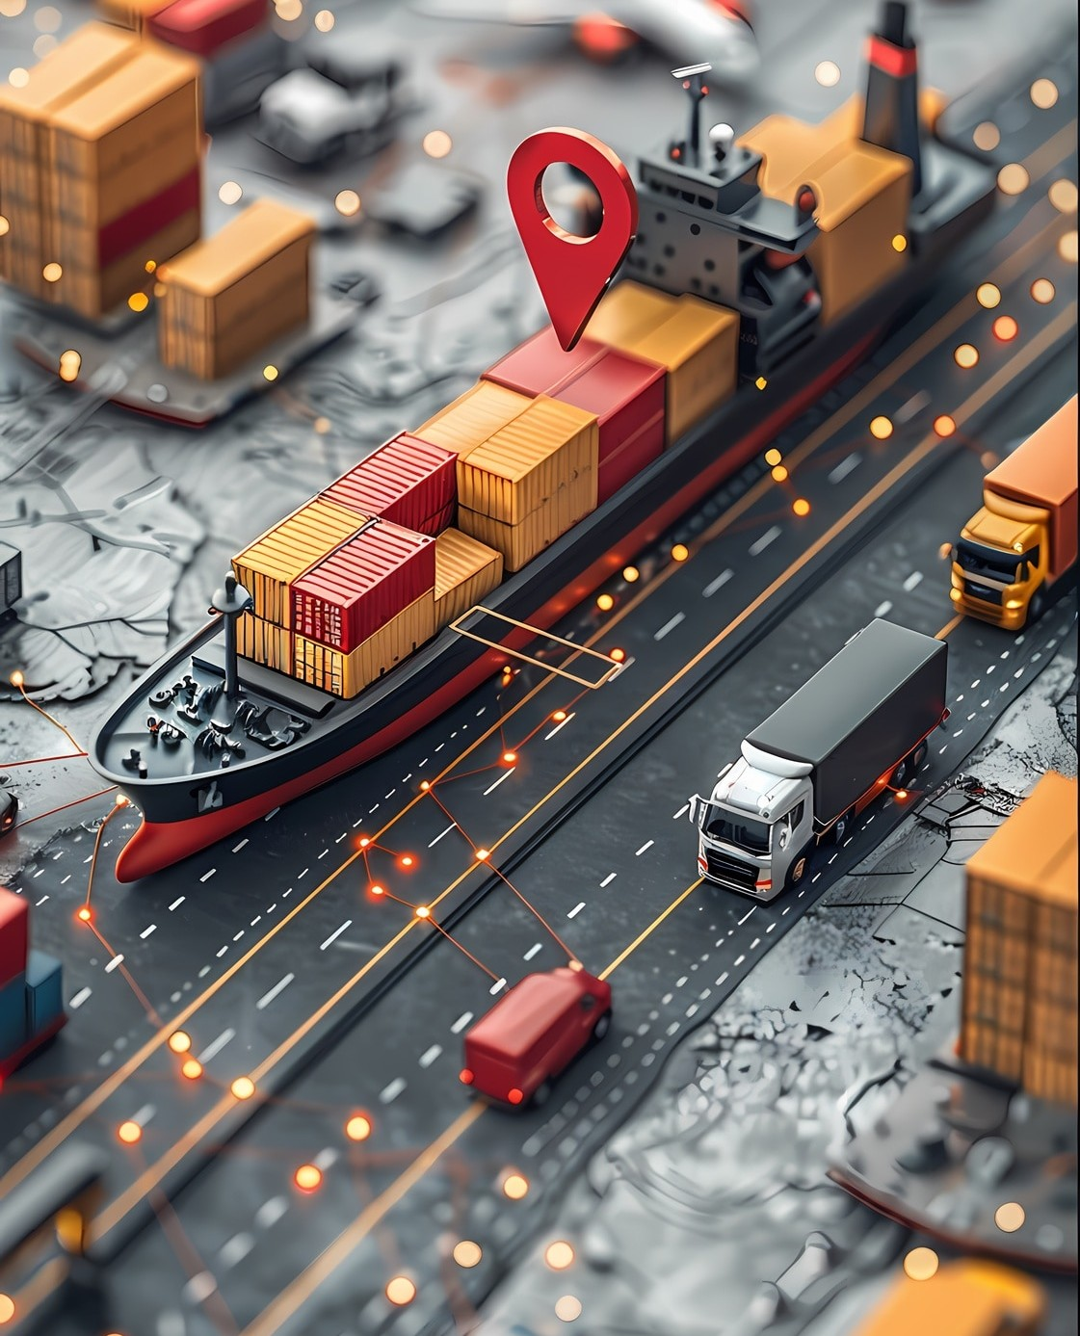






Introduction to Supply Chain
Supply Chain management is critical for enhancing operational efﬁciency. This presentation will explore Flipkart's strategic practices that optimize their supply chain, focusing on key elements such as logistics, technology, and supplier relationships.

Slide 3






Flipkart's Market Position
As one of India's leading e commerce platforms, Flipkart has established a robust market position. Its focus on customer satisfac and rapid delivery has set a benchmark for competitors, necessitating efﬁcient supply chain management.

Slide 4


Strategic Partnerships
Flipkart's success is partly due to its strategic partnerships with suppliers and logistics providers.
These alliances enable better inventory management and enhance delivery speed, ultimately improving overall customer experience.

Slide 5
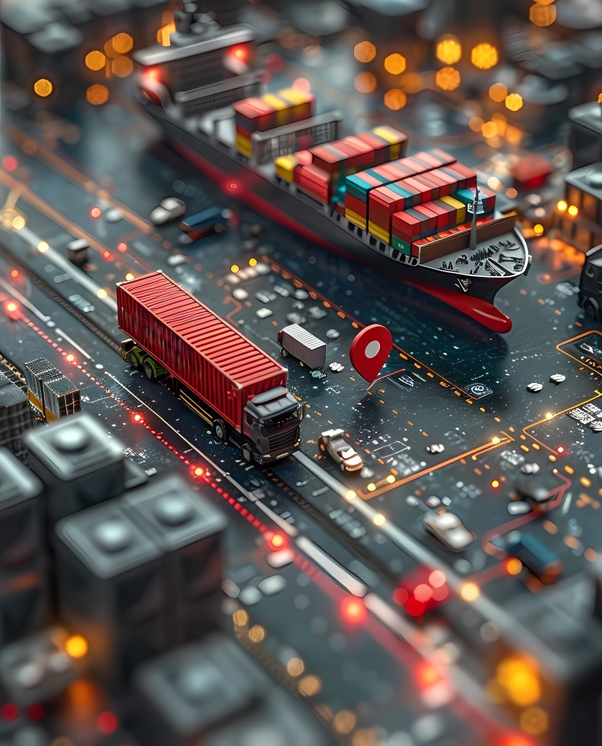


Technology Integration
The integration of technology in Flipkart's supply chain has revolutionized operations. Tools like data analytics and AI help in demand forecasting, optimizing routes, and managing inventory, leading to signiﬁcant efﬁciency gains.

Slide 6
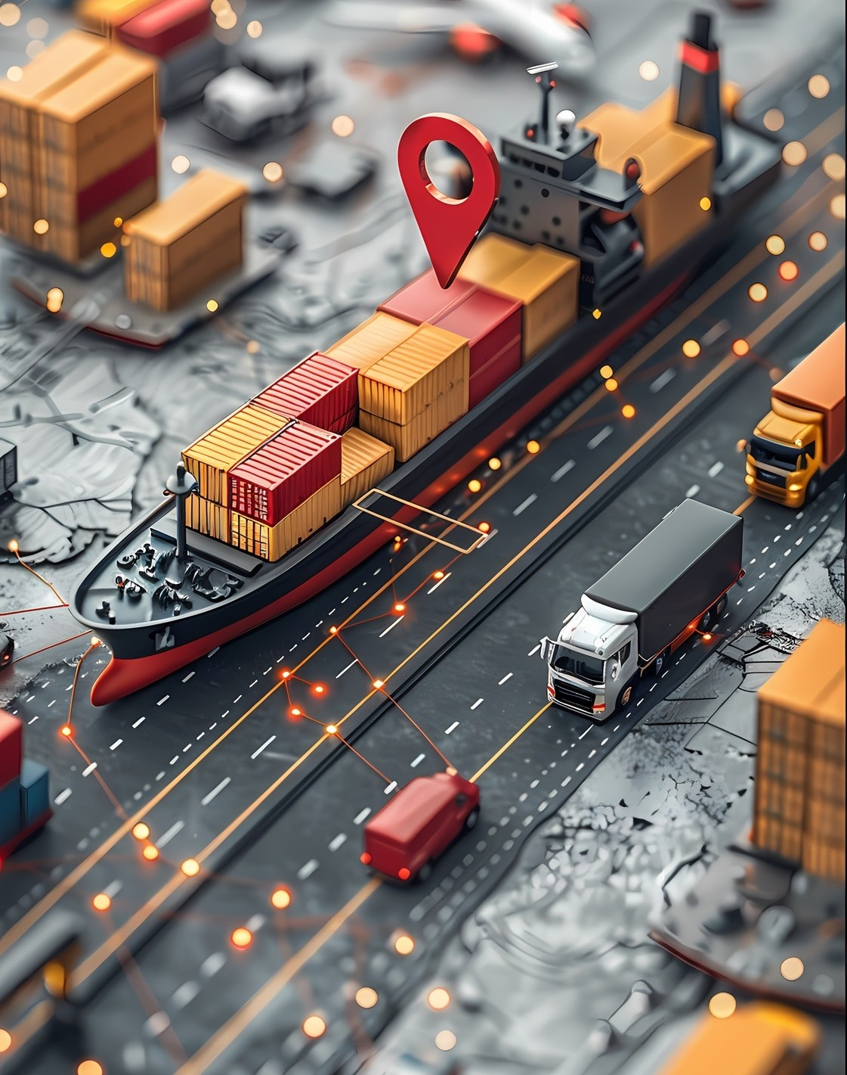



Logistics Optimization
Flipkart employs advanced logistics strategies to streamline operations. By utilizing warehouse automation and last-mile delivery solutions, they reduce costs and enhance the speed of order fulﬁllment.

Slide 7
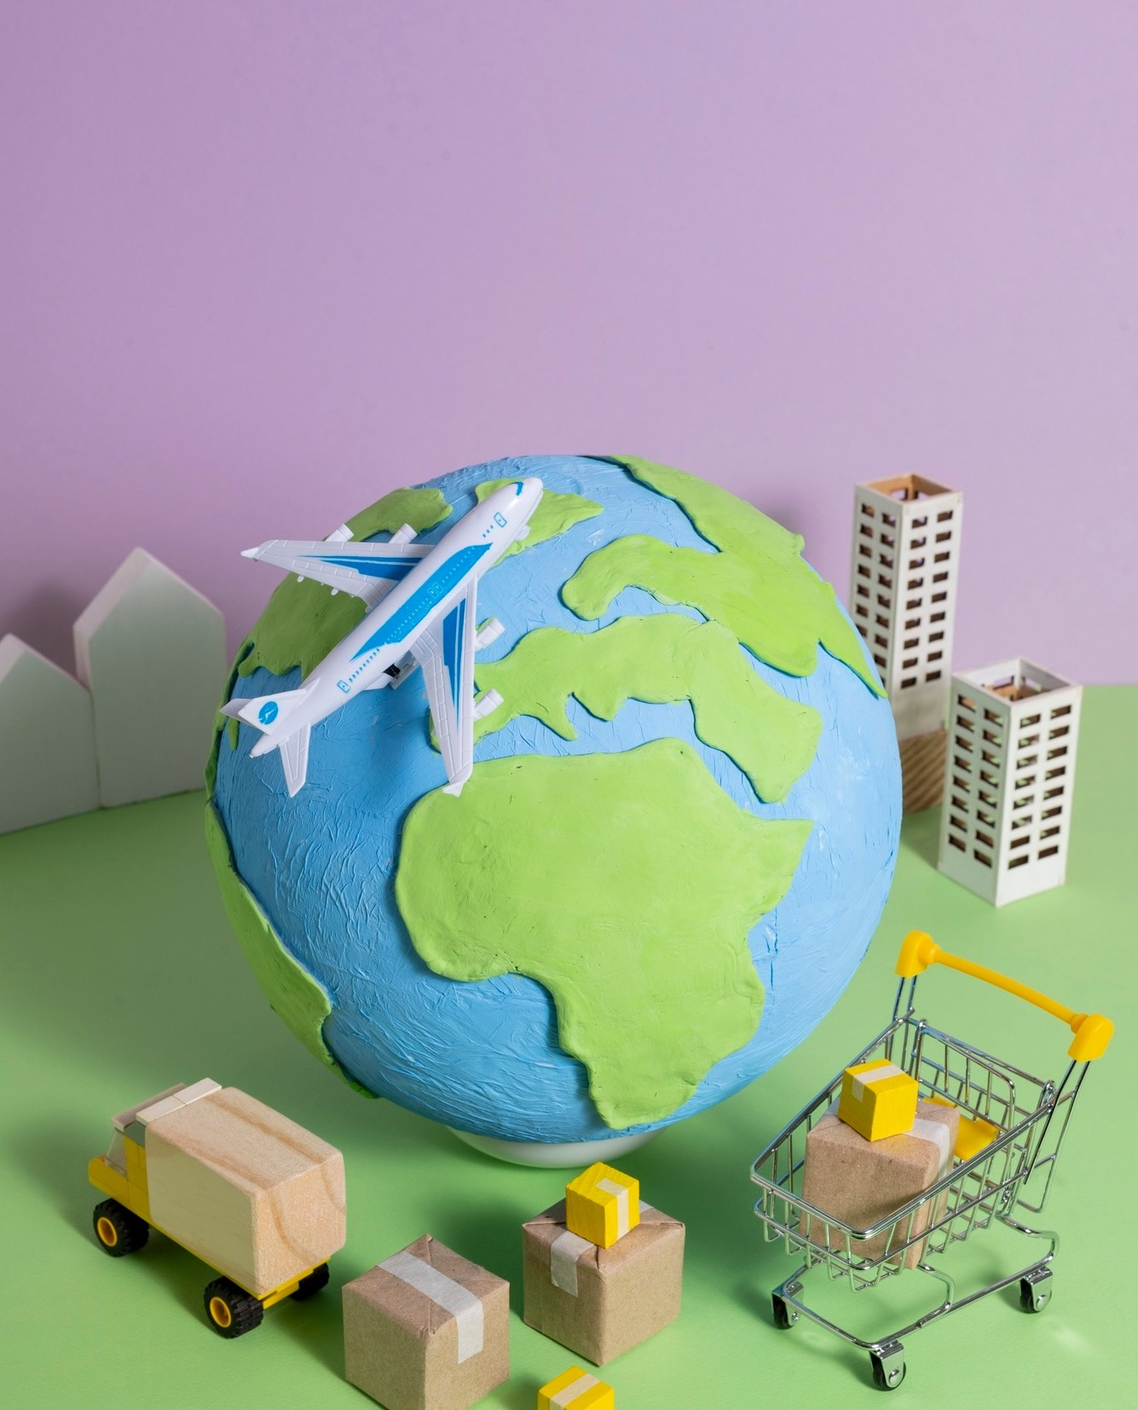

Sustainability Practices
In recent years, Flipkart has focused on sustainability in its supply chain. Implementing eco-friendly practices not only enhances brand reputation but also reduces operational costs, aligning with global environmental goals.

Slide 8
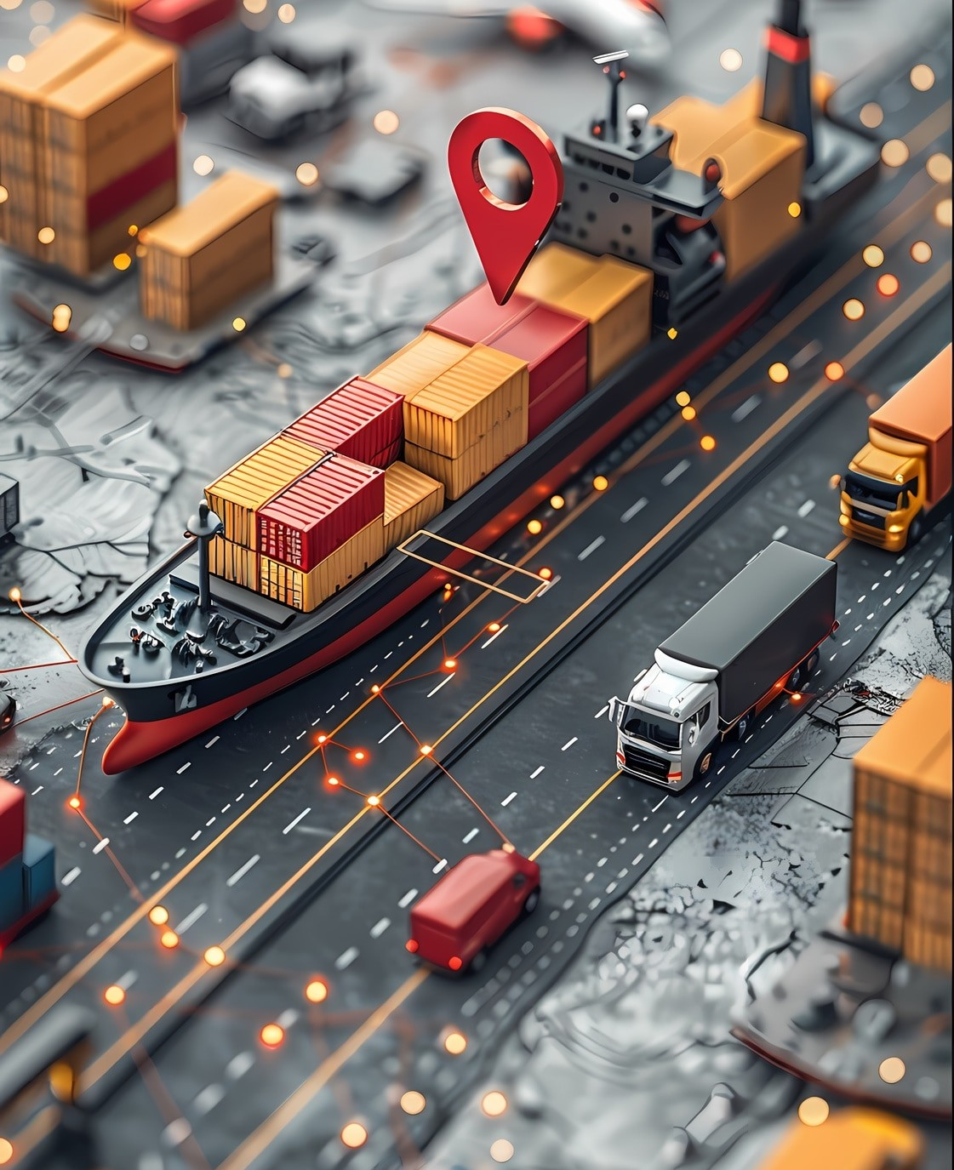


Challenges Faced
Despite its successes, Flipkart faces challenges such as supply chain disruptions and market competition. Addressing these issues requires continuous innovation and adaptability in their strategic management practices.

Slide 9



Conclusion and Future Outlook
In conclusion, Flipkart's strategic management practices in supply chain efﬁciency serve as a model for others. By leveraging technology, partnerships, and sustainability, Flipkart is well-positioned for future growth and resilience.

Slide 10
Thanks!

